Slide 1
Database Design: Inheritance and Complex Rules in Logical Models
Instructor: And Harr

Slide 2
Enhanced ER Models
Objectives:
Review complex relationships and inheritance
Specialization
Categorization
Aggregation
Learn how EER modeling grammar is modeled, validated, and implemented using the logical model

Slide 3
What is the EER?
An extension to ER modeling that allows more complex relationships to be modeled
Some complex relationships could only be retained in semantic integrity constraints
Modeling grammar allows the addition of superclass/subclass relationships which model:
Specialization/generalization
Categorization
Aggregation

Slide 4
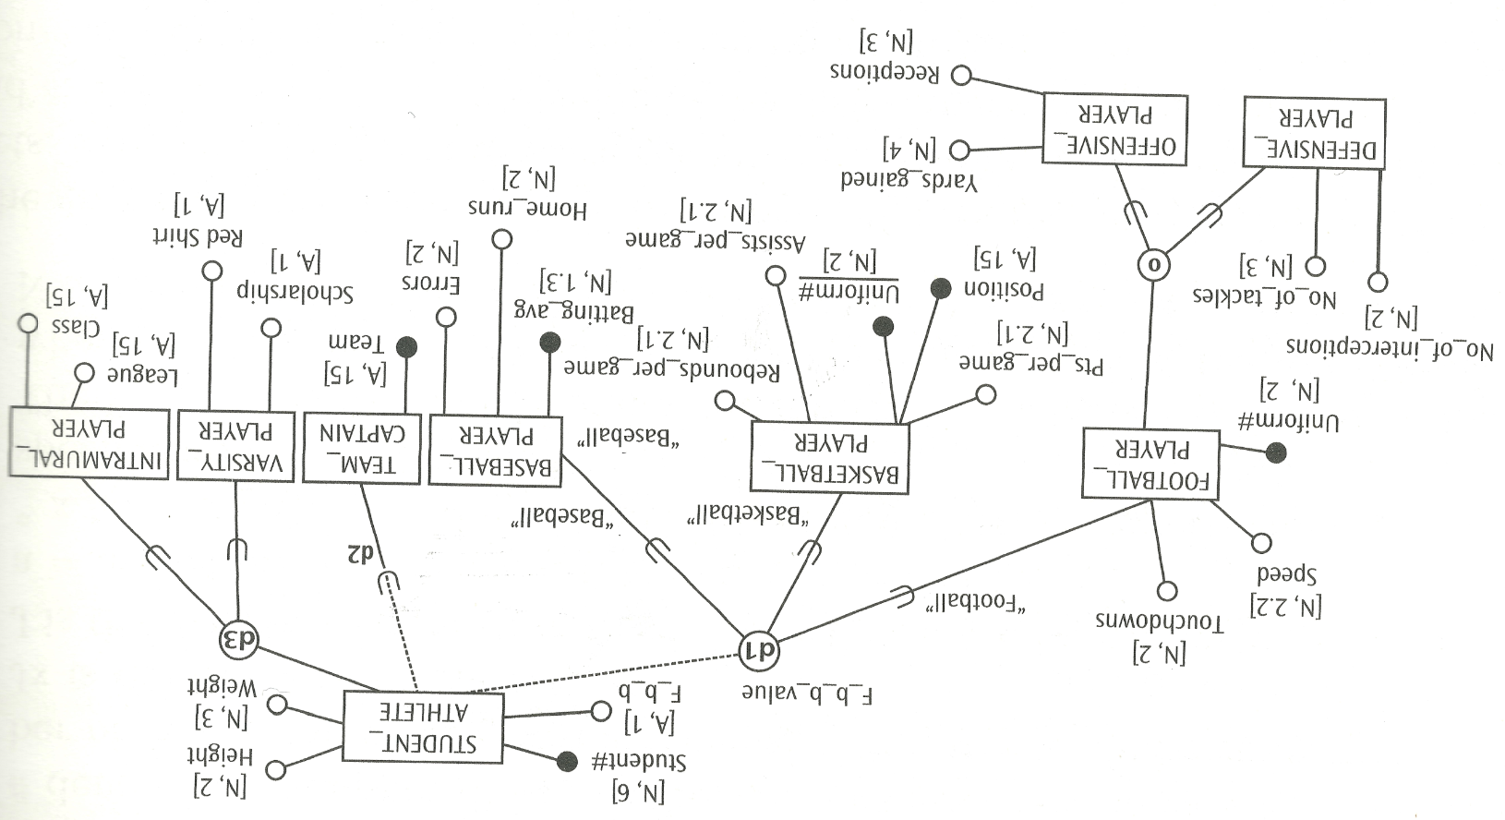
Fine Grained DS-ERM

Slide 5
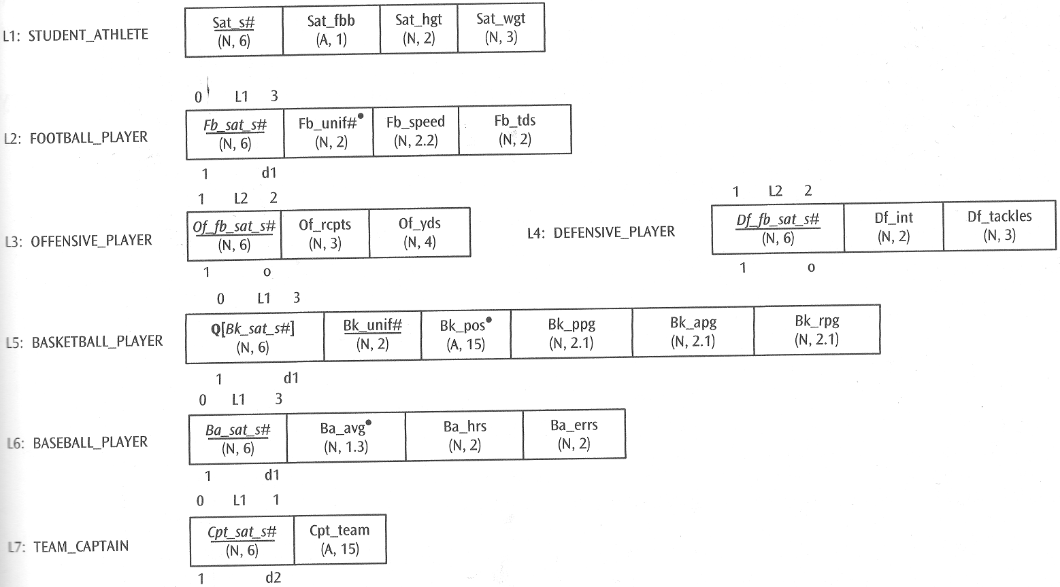
Converting to Logical Model
Could this be combined into single table?
Or 3 Tables?

Slide 6
Converting to Logical Model
Why 0, why 3?
Why 0, why 1?
Why o, d1, d2?

Slide 7
Converting to Logical Model
These represent fundamentally different approaches – why?

Slide 8
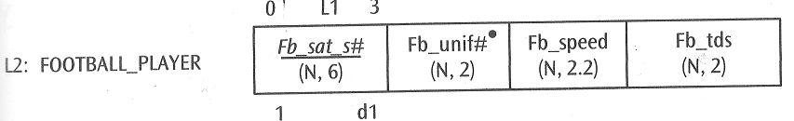
Ramifications
When using this approach, does a football player have to be a student athlete?
Does this change any FD’s?
Does this change any MVD’s?
Does this change any JD’s?
Are there any problems associated with this model specification?
How are the problems related to the assumptions of the model?
How would you resolve them?

Slide 9

Ramifications
When using this approach, does a basketball player have to be a student athlete?
Does this change any FD’s?
Does this change any MVD’s?
Does this change any JD’s?
Are there any problems associated with this model specification?
How are the problems related to the assumptions of the model?
How would you resolve them?

Slide 10
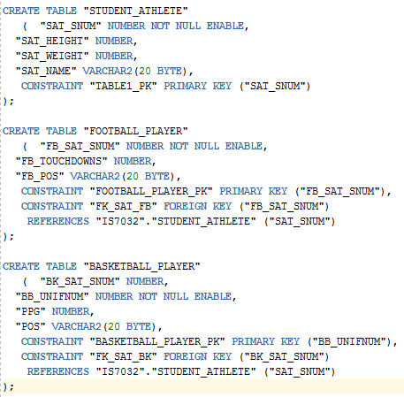
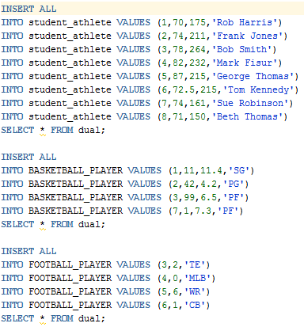
Test It

Slide 11




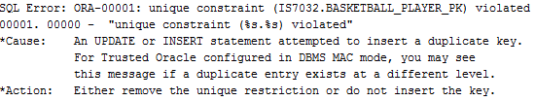
What Happened?

Slide 12
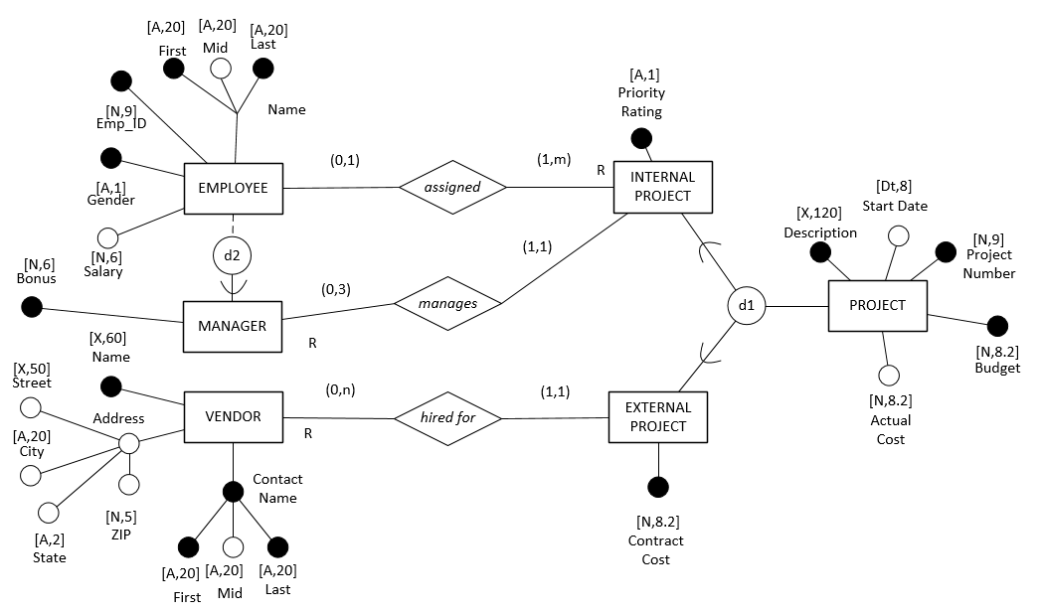
Example
Convert this DS-ERD to a logical model; notice unique ID’s are missing

Slide 13

Create Arc-Directed Model

Slide 14
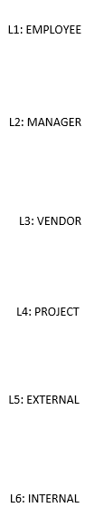
Create Dependency Diagrams
In this example, we are assuming we would ignore the transitive dependency due to address

Slide 15
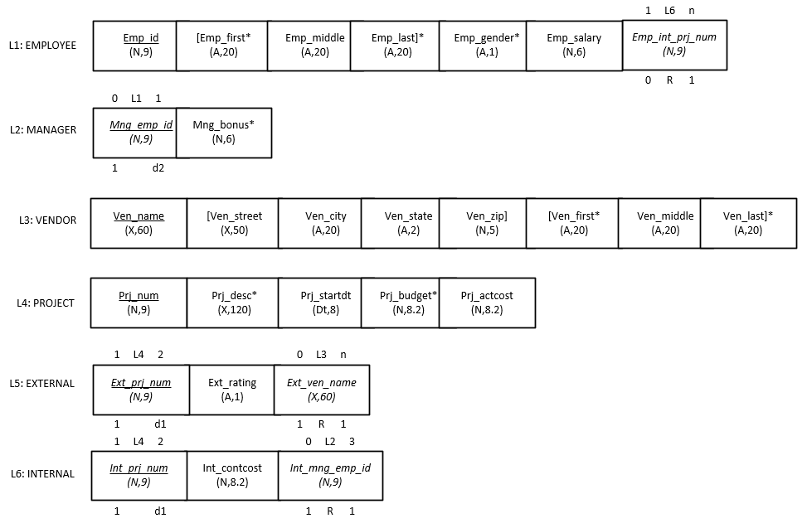
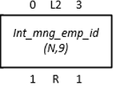


Create Information Preserving Logical Model

Slide 16
Remember This?

Slide 17
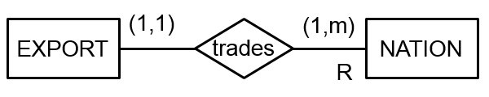
Model Validation
Directed Arc Model
NATION
EXPORT
Origin | Tax
Japan | 15
USA | 0
Italy | 18
Canada | 0
Mexico | 15
Korea | 15
Model | Cylinders | Origin | Fee
Camry | 4 | Japan | 30
Mustang | 6 | USA | 45
Fiat | 4 | Italy | 30
Accord | 4 | Japan | 30
Century | 8 | USA | 60
Mustang | 4 | Canada | 30
Monte Carlo | 6 | Canada | 45
Civic | 4 | Japan | 30
Mustang | 4 | Mexico | 30
Mustang | 6 | Mexico | 45
Civic | 4 | Korea | 30
Origin
Tax
Model
Cylinders
Origin
Fee
Dependency Diagram
Some undesirable FD’s exist
NATION
Origin
Tax
EXPORT
Model
Cylinders
Origin
Fee

Slide 18
Functional Dependencies
Directed Arc Model
NATION
EXPORT
Origin | Tax
Japan | 15
USA | 0
Italy | 18
Canada | 0
Mexico | 15
Korea | 15
Model | Origin | Cylinders
Camry | Japan | 4
Mustang | USA | 6
Fiat | Italy | 4
Accord | Japan | 4
Century | USA | 8
Mustang | Canada | 4
Monte Carlo | Canada | 6
Civic | Japan | 4
Mustang | Mexico | 4
Mustang | Mexico | 6
Civic | Korea | 4
NATION
Origin
Tax
EXPORT
Model
Cylinders
Origin
Fee
MOTOR_FEE
Cylinders | Fee
4 | 30
6 | 45
8 | 60
MOTOR_FEE
Cylinders
Fee
Dependency Diagram
NATION
Origin
Tax
MOTOR_FEE
Cylinders
Fee
Only desirable FD’s exist;
what normal form is this?
EXPORT
Model
Cylinders
Origin

Slide 19
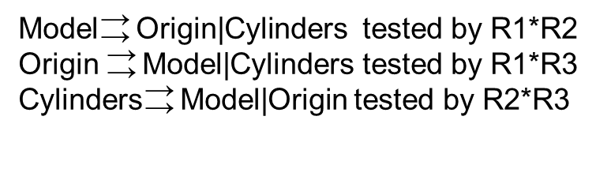
Multi-Valued Dependencies
NATION
EXPORT
Origin | Tax
Japan | 15
USA | 0
Italy | 18
Canada | 0
Mexico | 15
Korea | 15
Model | Origin | Cylinders
Camry | Japan | 4
Civic | Japan | 4
Accord | Japan | 4
Mustang | USA | 6
Century | USA | 8
Mustang | Canada | 4
Monte Carlo | Canada | 6
Mustang | Mexico | 4
Mustang | Mexico | 6
Civic | Korea | 4
Fiat | Italy | 4
MOTOR_FEE
R1
R2
R3
Cylinders | Fee
4 | 30
6 | 45
8 | 60
Model | Origin
Camry | Japan
Civic | Japan
Accord | Japan
Mustang | USA
Century | USA
Mustang | Canada
Monte Carlo | Canada
Mustang | Mexico
Civic | Korea
Fiat | Italy
Model | Cylinders
Camry | 4
Civic | 4
Accord | 4
Century | 8
Monte Carlo | 6
Mustang | 4
Mustang | 6
Fiat | 4
Origin | Cylinders
Japan | 4
USA | 6
USA | 8
Canada | 4
Canada | 6
Mexico | 4
Mexico | 6
Korea | 4
Italy | 4

Slide 20
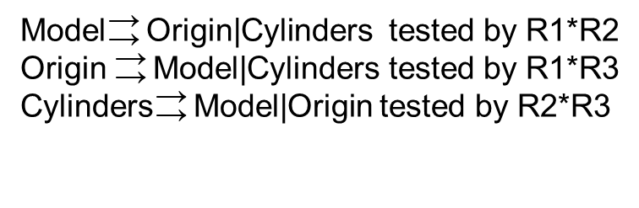
Multi-Valued Dependencies
R2*R3
Model | Cylinders | Origin
Camry | 4 | Japan
Camry | 4 | Canada
Camry | 4 | Mexico
Camry | 4 | Korea
Camry | 4 | Italy
Civic | 4 | Japan
Civic | 4 | Canada
Civic | 4 | Mexico
Civic | 4 | Korea
Civic | 4 | Italy
Accord | 4 | Japan
Accord | 4 | Canada
Accord | 4 | Mexico
Accord | 4 | Korea
Accord | 4 | Italy
Mustang | 4 | Japan
Mustang | 4 | Canada
Mustang | 4 | Mexico
Mustang | 4 | Korea
Mustang | 4 | Italy
Fiat | 4 | Japan
Fiat | 4 | Canada
Fiat | 4 | Mexico
Fiat | 4 | Korea
Fiat | 4 | Italy
Century | 8 | USA
Monte Carlo | 6 | USA
Monte Carlo | 6 | Canada
Monte Carlo | 6 | Mexico
Mustang | 6 | USA
Mustang | 6 | Canada
Mustang | 6 | Mexico
All MVD’s are trivial and decompositions would contain loss-joins
R1*R2
R1*R3
Model | Origin | Cylinders
Camry | Japan | 4
Civic | Japan | 4
Accord | Japan | 4
Century | USA | 8
Monte Carlo | Canada | 6
Civic | Korea | 4
Fiat | Italy | 4
Mustang | Mexico | 4
Mustang | Mexico | 6
Mustang | Canada | 4
Mustang | Canada | 6
Mustang | USA | 4
Mustang | USA | 6
Model | Origin | Cylinders
Camry | Japan | 4
Civic | Japan | 4
Accord | Japan | 4
Mustang | USA | 6
Mustang | USA | 8
Century | USA | 6
Century | USA | 8
Mustang | Canada | 4
Mustang | Canada | 6
Monte Carlo | Canada | 4
Monte Carlo | Canada | 6
Mustang | Mexico | 4
Mustang | Mexico | 6
Civic | Korea | 4
Fiat | Italy | 4
R
Model | Origin | Cylinders
Camry | Japan | 4
Mustang | USA | 6
Fiat | Italy | 4
Accord | Japan | 4
Century | USA | 8
Mustang | Canada | 4
Monte Carlo | Canada | 6
Civic | Japan | 4
Mustang | Mexico | 4
Mustang | Mexico | 6
Civic | Korea | 4

Slide 21
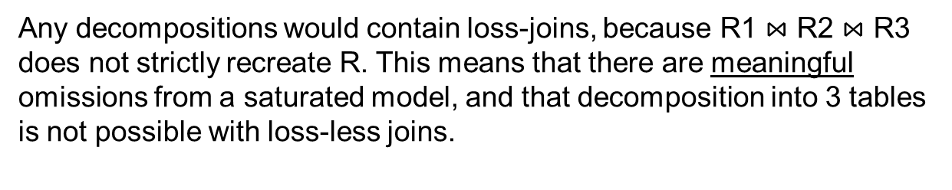

Join Dependencies
R
Model | Origin | Cylinders
Camry | Japan | 4
Civic | Japan | 4
Accord | Japan | 4
Mustang | USA | 4
Mustang | USA | 6
Century | USA | 8
Mustang | Canada | 4
Mustang | Canada | 6
Monte Carlo | Canada | 6
Mustang | Mexico | 4
Mustang | Mexico | 6
Civic | Korea | 4
Fiat | Italy | 4
Model | Origin | Cylinders
Camry | Japan | 4
Mustang | USA | 6
Fiat | Italy | 4
Accord | Japan | 4
Century | USA | 8
Mustang | Canada | 4
Monte Carlo | Canada | 6
Civic | Japan | 4
Mustang | Mexico | 4
Mustang | Mexico | 6
Civic | Korea | 4

Slide 22
Solution
NATION
EXPORT
Directed Arc Model
Origin | Tax
Japan | 15
USA | 0
Italy | 18
Canada | 0
Mexico | 15
Korea | 15
Model | Origin | Cylinders
Camry | Japan | 4
Mustang | USA | 6
Fiat | Italy | 4
Accord | Japan | 4
Century | USA | 8
Mustang | Canada | 4
Monte Carlo | Canada | 6
Civic | Japan | 4
Mustang | Mexico | 4
Mustang | Mexico | 6
Civic | Korea | 4
NATION
Origin
Tax
EXPORT
Model
Cylinders
Origin
MOTOR_FEE
Cylinders | Fee
4 | 30
6 | 45
8 | 60
MOTOR_FEE
Cylinders
Fee
Consequently, the highest level of decomposition we can engage in for this model is 3NF/BCNF. We have validated the design above.
If Canada produced a 6 cylinder Mustang, and USA produced a 4 cylinder Mustang, then we could decompose the EXPORT table into 3 component binary tables.

Slide 23
Information Preserving Logical Model
EXPORT
NATION
MOTOR_FEE
Model | Origin | Cylinders
Camry | Japan | 4
Mustang | USA | 6
Fiat | Italy | 4
Accord | Japan | 4
Century | USA | 8
Mustang | Canada | 4
Monte Carlo | Canada | 6
Civic | Japan | 4
Mustang | Mexico | 4
Mustang | Mexico | 6
Civic | Korea | 4
Origin | Tax
Japan | 15
USA | 0
Italy | 18
Canada | 0
Mexico | 15
Korea | 15
Cylinders | Fee
4 | 30
6 | 45
8 | 60
Thus, we have validated this logical model.
L1: NATION
Origin
(A,20)
Tax*
(N,2)
1 L3 n
1 L1 n
L2: EXPORT
Model
(A, 20)
Cylinders
(N,1)
Origin
(A,20)
1 R 1
1 R 1
L3: MOTOR_FEE
Cylinders
(N,1)
Fee*
(N,2)

Slide 24
What if…
If Canada did produce 6 cylinder Mustangs, and USA produced 4 cylinder Mustangs, this solution is more efficient but has less constraints.
L1: NATION
Origin
(A,20)
Tax*
(N,2)
Notice the relationships now fit a cascading 1:m pattern which reduces anomalies.
But how do the tables join this way?
What is the cost of modeling this way?
1 L1 n
L2: EXPORT_R1
Model
(A, 20)
Origin
(A,20)
1 R 1
1 L5 n
L3: EXPORT_R2
Model
(A, 20)
Cylinders
(N,1)
1 R 1
1 L5 n
1 L1 n
L4: EXPORT_R3
Cylinders
(N,1)
Origin
(A,20)
1 R 1
1 R 1
L5: MOTOR_FEE
Cylinders
(N,1)
Fee*
(N,2)

Slide 25
What if…
If Canada did produce 6 cylinder Mustangs, and USA produced 4 cylinder Mustangs, this would be a solution more robust to anomalies.
L1: NATION
Origin
(A,20)
Tax*
(N,2)
1 L2 n
L2: EXPORT_R1
Model
(A, 20)
Origin
(A,20)
1 L4 n
1 L3 n
1 L5 n
1 L1 n
L3: EXPORT_R2
Model
(A, 20)
Cylinders
(N,1)
L6: EXPORT
Model
(A, 20)
Cylinders
(N,1)
Origin
(A,20)
1 R 1
1 R 1
1 R 1
L4: EXPORT_R3
Cylinders
(N,1)
Origin
(A,20)
1 R 1
1 R 1
L5: MOTOR_FEE
Cylinders
(N,1)
Fee*
(N,2)

Slide 26
Summary
EER modeling enhances the conceptual model to reflect:
Specialization
Categorization
Aggregation
Inheritance modeling grammar can be converted to the logical design layer to avoid the loss of important contextual information
Inheritance relationships can also be validated using the same general principles from 1NF to 5NF

